Slide 1
Data Structures and Algorithms (ESO207)
Lecture 10:
Exploring nearly balanced BST for the directory problem
Stack: a new data structure

Slide 2
Binary Search Tree (BST)
Definition: A Binary Tree T storing values is said to be Binary Search Tree
if for each node v in T
If left(v) <> NULL, then …
If right(v)<>NULL, then …
head
46
28
67
5
35
49
83
2
25
31
41
48
53
73
96
value(v) > value of every node in subtree(left(v)).
value(v) < value of every node in subtree(right(v)).

Slide 3
A question
Time complexity of
Search(T,x) and Insert(T,x) in a Binary Search Tree T = ??
O(Height(T))

Slide 4

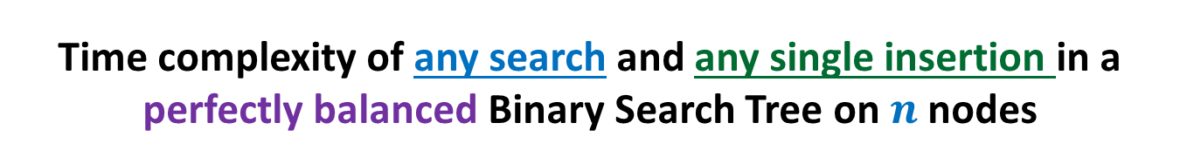
Time complexity of any search and any single insertion in a perfectly balanced Binary Search Tree on $n$ nodes
T
O( log $n$) time
46
28
67
5
35
49
83
2
25
31
41
48
53
73
96

Slide 5

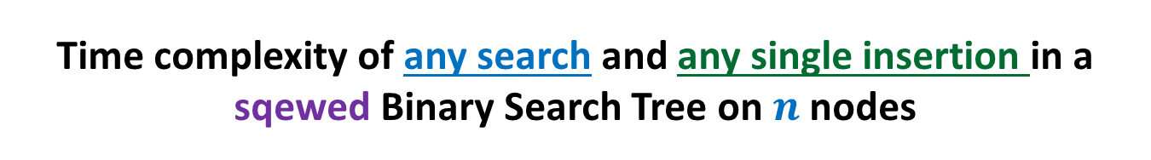
Time complexity of any search and any single insertion in a sqewed Binary Search Tree on $n$ nodes
T’
48
39
23
19
11
O($n$) time !☹
14
18

Slide 6

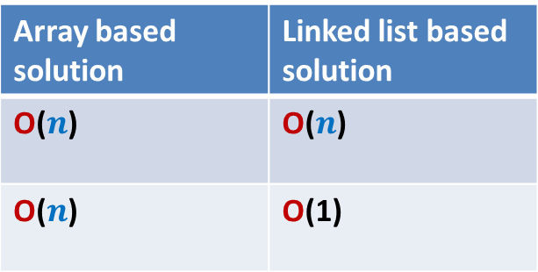
Our Original Problem
Maintain a telephone directory
Operations:
Search the phone # of a person with name x
Insert a new record (ID no., phone #,…)
Solution : We may keep perfectly balanced BST.
Hurdle: What if we insert records in increasing order of ID ?
BST will be skewed ☹
BST data structure that we invented looks very elegant,
let us try to find a way to overcome the hurdle.
Array based solution | Linked list based solution
O($n$) | O($n$)
O($n$) | O(1)
ID no.
Log $n$
Log $n$

Slide 7
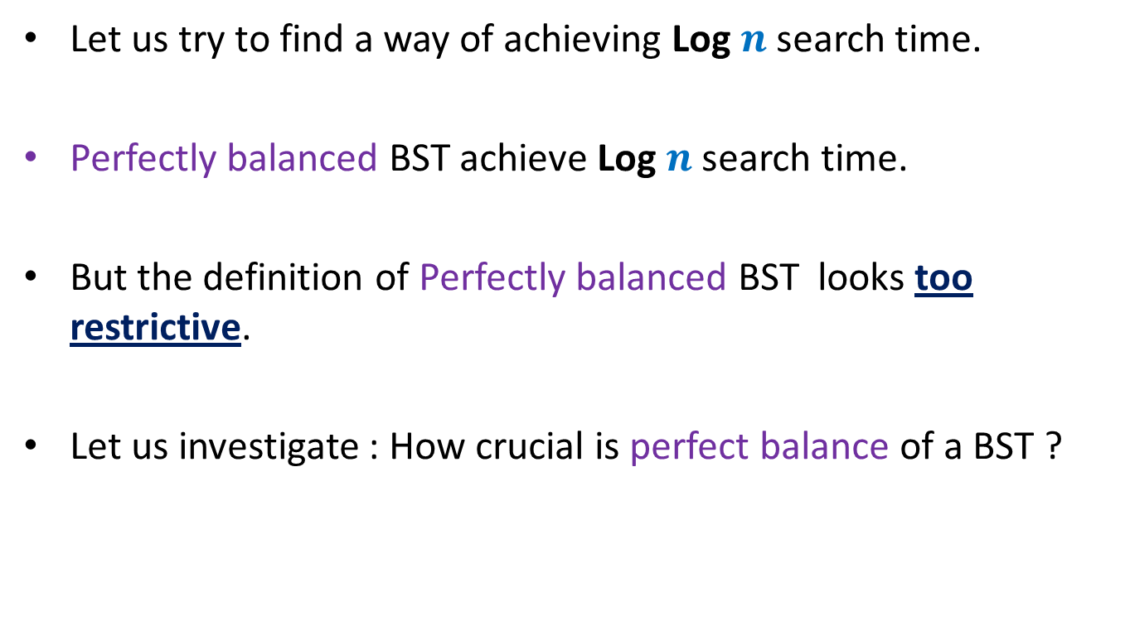
Let us try to find a way of achieving Log $n$search time.
Perfectly balanced BST achieve Log $n$search time.
But the definition of Perfectly balanced BST looks too restrictive.
Let us investigate : How crucial is perfect balance of a BST ?

Slide 8




How crucial is perfect balance of a BST ?
$H(1)$ = 0
$H(n)$ = $≤1+H\left(\frac{n}{2}\right)$
Let us change this recurrence slightly.
$$≤\frac{n}{2}$$
$$≤\frac{n}{2}$$
$$n$$

Slide 9
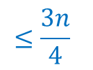

How crucial is perfect balance of a BST ?
$H(1)$ = 0
$H(n)$ $≤1+H\left(\frac{3n}{4}\right)$
$≤1+1+H\left({\left(\frac{3}{4}\right)}^{2}n\right)$
$≤1+1+…+ H\left({\left(\frac{3}{4}\right)}^{i}n\right)$
$≤$ $\log_{4/3} n$
$$≤\frac{3n}{4}$$
What lesson did you get from this recurrence ?
Think for a while before going further …
$$n$$
Lesson learnt :
We may as well work with nearly balanced BST

Slide 10
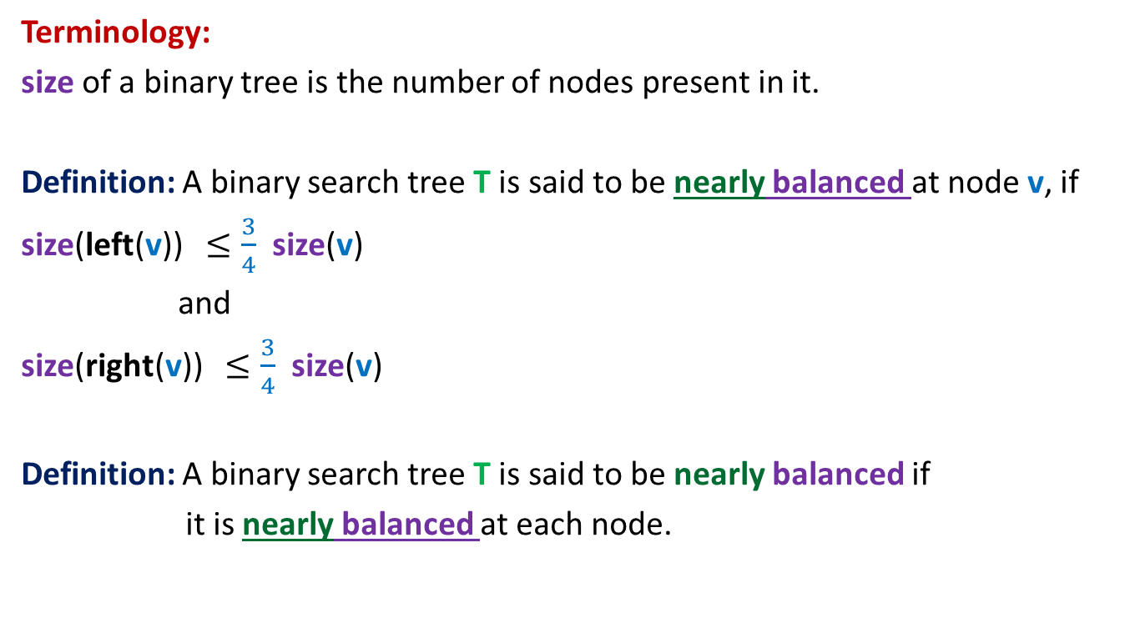
Nearly balanced Binary Search Tree
Terminology:
size of a binary tree is the number of nodes present in it.
Definition: A binary search tree T is said to be nearly balanced at node v, if
size(left(v)) $≤\frac{3}{4}$ size(v)
and
size(right(v)) $≤\frac{3}{4}$ size(v)
Definition: A binary search tree T is said to be nearly balanced if
it is nearly balanced at each node.

Slide 11
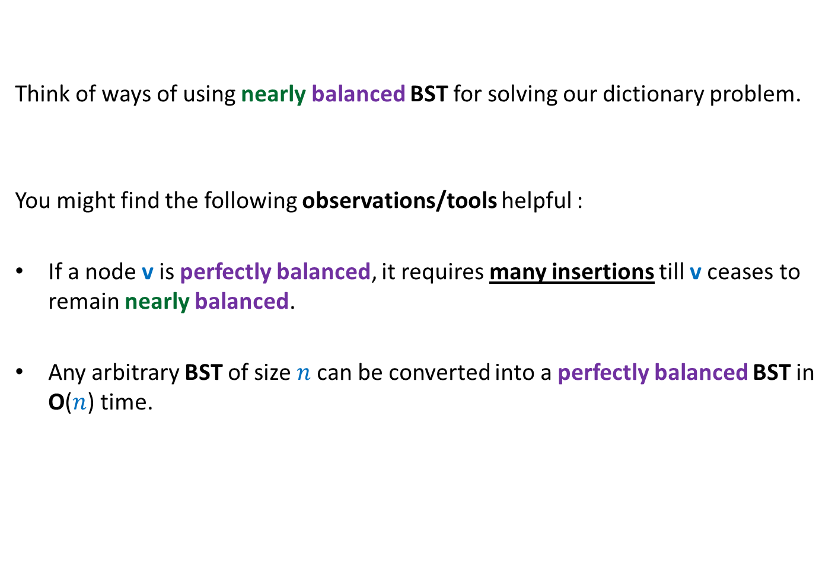
Nearly balanced Binary Search Tree
Think of ways of using nearly balanced BST for solving our dictionary problem.
You might find the following observations/tools helpful :
If a node v is perfectly balanced, it requires many insertions till v ceases to remain nearly balanced.
Any arbitrary BST of size $n$can be converted into a perfectly balanced BST in O($n$) time.

Slide 12

Solving our dictionary problem Preserving O(log $n$) height after each operation
Each node v in T maintains an additional field
size(v) which is the number of nodes in the subtree(v).
Keep Search(T,x) operation unchanged.
Modify Insert(T,x) operation as follows:
Carry out normal insert and update the size fields of nodes traversed.
If BST T is ceases to be nearly balanced at any node v,
transform subtree(v) into perfectly balanced BST.

Slide 13


“Perfectly Balancing” subtree at a node v
v
> $\frac{3}{4}k$
$$k$$
$$k$$
Size differs by at most 1

Slide 14
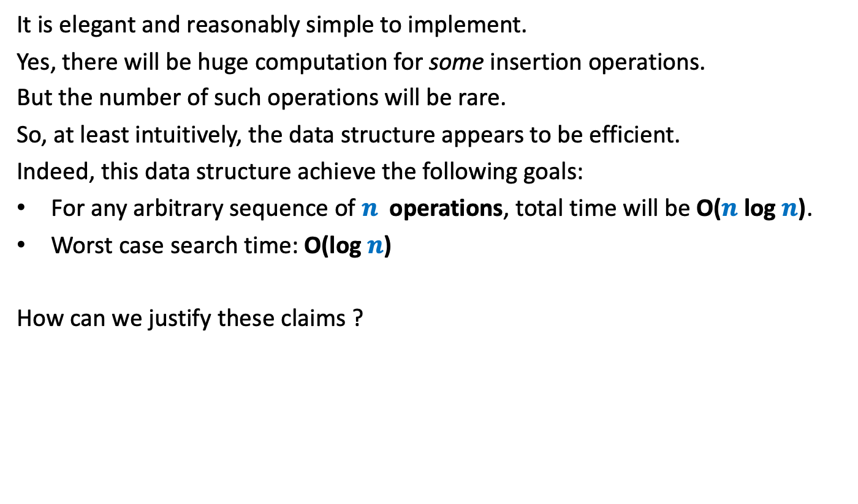
What can we say about this data structure ?
It is elegant and reasonably simple to implement.
Yes, there will be huge computation for some insertion operations.
But the number of such operations will be rare.
So, at least intuitively, the data structure appears to be efficient.
Indeed, this data structure achieve the following goals:
For any arbitrary sequence of $n$ operations, total time will be O($n$log $n$).
Worst case search time: O(log $n$)
How can we justify these claims ?
Keep thinking till we do it in a few weeks ☺.

Slide 15
Stack: a data structure
A few motivating examples

Slide 16
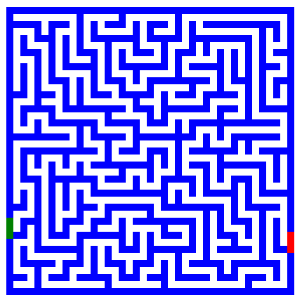
Finding path in a maze
Problem : How to design an algorithm for finding a path in a maze ?

Slide 17
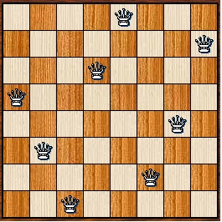
8-Queens Problem
Problem: How to place 8 queens on a chess board
so that no two of them attack each other ?

Slide 18

Expression Evaluation
$x = 3+4∗(5−6∗(8+9^2)+3)$
Problem:
Can you write a program to evaluate any arithmetic expression ?

Slide 19
Stack: a data structure

Slide 20
Stack
Data Structure Stack:
Mathematical Modeling of Stack
Implementation of Stack
will be left as an exercise

Slide 21


Revisiting List
List is modeled as a sequence of elements.
we can insert/delete/query element
L : $a_{1}$, $a_{2}$, …, $a_{i−1}, a_{i}$, $a_{i+1}$, …, $a_{n}$
at any arbitrary position in the list.
Top
$i$th element of list L
What if we restrict all these operations to take place only at one end of the list ?

Slide 22

Stack: a new data structure
A special kind of list
where all operations (insertion, deletion, query) take place at one end only,
called the top.
top
$$a_{1}$$
$$a_{2}$$
$$a_{n}$$

Slide 23
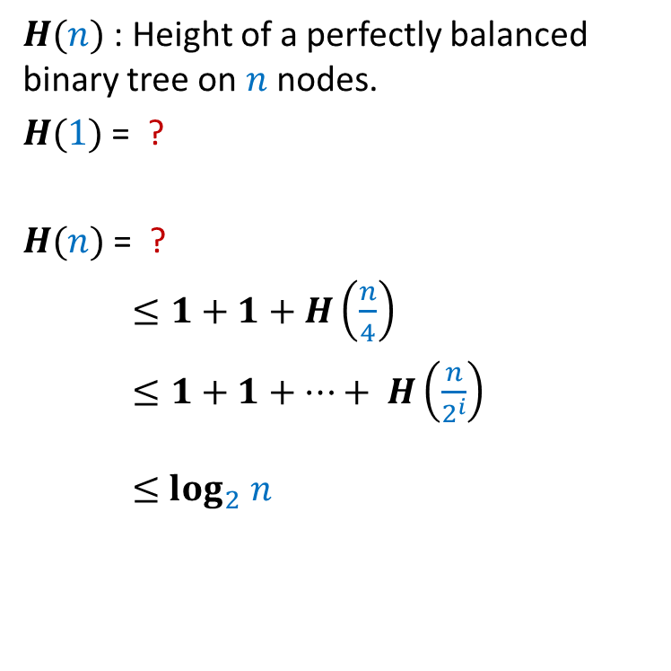
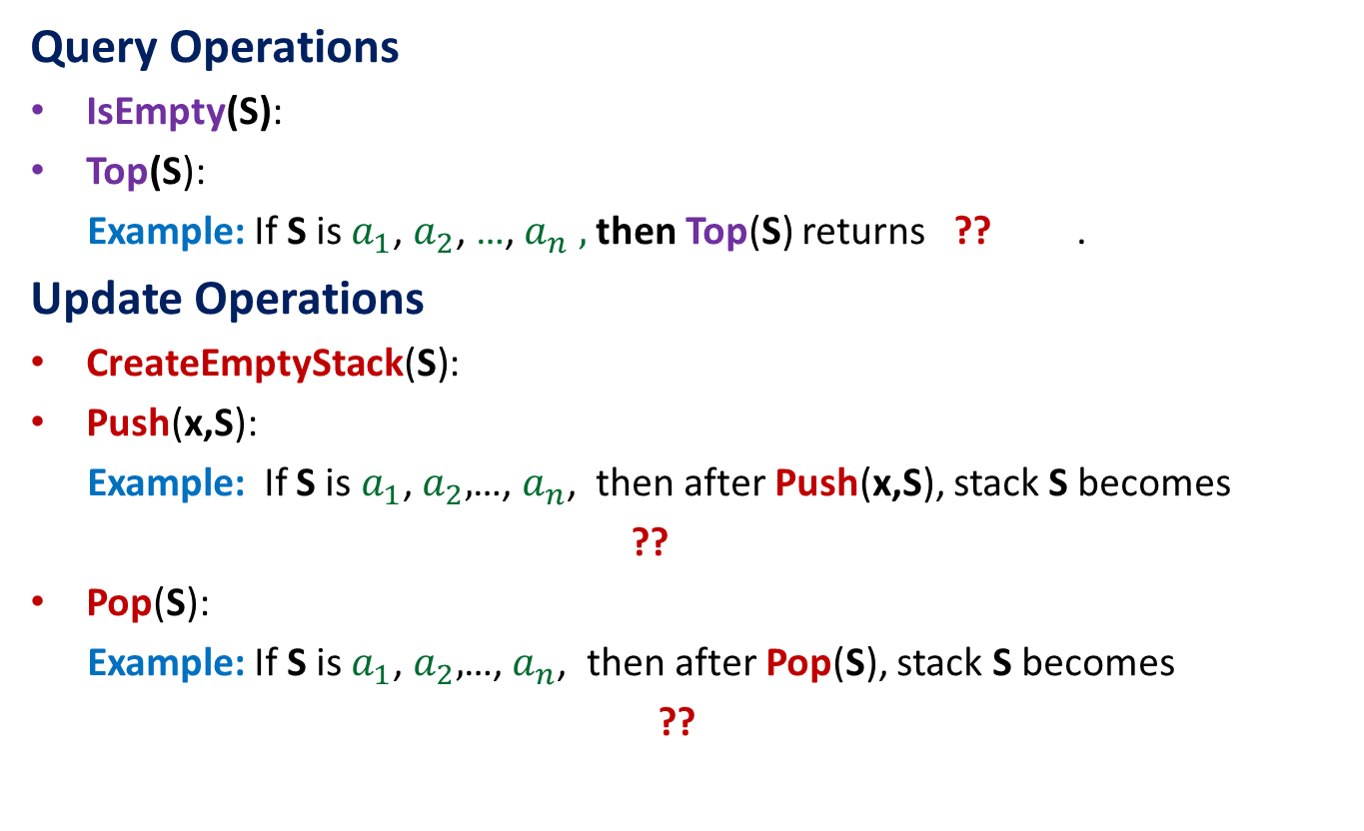


Operations on a Stack
Query Operations
IsEmpty(S):
Top(S):
Example: If S is $a_{1}$, $a_{2}$, …,${ a}_{n} ,$ then Top(S) returns ?? .
Update Operations
CreateEmptyStack(S):
Push(x,S):
Example: If S is $a_{1}$, $a_{2},$…, $a_{n}$, then after Push(x,S), stack S becomes
??
Pop(S):
Example: If S is $a_{1}$, $a_{2},$…, $a_{n}$, then after Pop(S), stack S becomes
??
determine if S is an empty stack
returns the element at the top of the stack
$$a_{1}$$
Create an empty stack
push x at the top of the stack S
${x, a}_{1}$, $a_{2}$ ,…, $a_{n}$
Delete element from top of the stack S
$a_{2}$ ,…, $a_{n}$

Slide 24

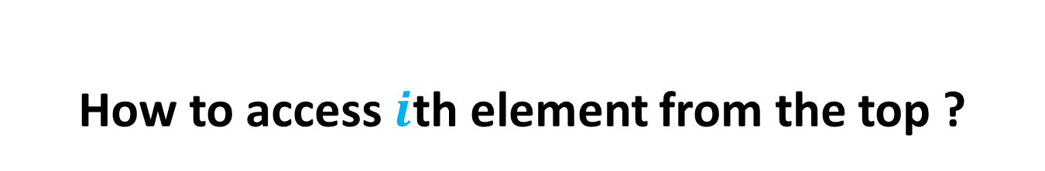

How to access $i$th element from the top ?
An Important point about stack
To access $i$th element, we must
pop (hence delete) one by one the top $i−1$ elements from the stack.
$$a_{1}$$
$$a_{i−1}$$
$$a_{i}$$
$$a_{n}$$

Slide 25
A puzzling question/confusion
Why do we restrict the functionality of a list ?
What will be the use of such restriction ?

Slide 26
How to evaluate an arithmetic expression

Slide 27
Evaluation of an arithmetic expression
Question: How does a computer/calculator
evaluate an arithmetic expression given in the form of a string of symbols ?
8 + 3 * 5 ^ 2 – 9

Slide 28
Evaluation of an arithmetic expression
Question: How does a computer/calculator
evaluate an arithmetic expression given in the form of a string of symbols ?
8 + 3 * 5 ^ 2 – 9
First it splits the string into tokens which are operators or operands (numbers). This is not difficult. But how does it evaluate it finally ???
operators
operands

Slide 29
Precedence of operators
Precedence: “priority” among different operators
Operator + has same precedence as –.
Operator * (as well as /) has higher precedence than +.
Operator * has same precedence as /.
Operator ^ has higher precedence than * and /.

Slide 30
Associativity of operators
What is 2^3^2 ?
What is 3-4-2 ?
What is 4/2/2 ?
Associativity:
“How to group operators of same type ?”
A ● B ● C = ??
(A ● B) ● C or A ● (B ● C)
Left associative
Right associative

Slide 31
A trivial way to evaluate an arithmetic expression
First perform all ^ operations.
Then perform all * and / operations.
Then perform all + and - operations.
Disadvantages:
An ugly and case analysis based algorithm
Multiple scans of the expression (one for each operator).
What about expressions involving parentheses: 3+4*(5-6/(8+9^2)+33)
What about associativity of the operators:
2^3^2 = 512 and not 64
16/4/2 = 2 and not 8.
8
+
3
5
2
-
*
^
9

Slide 32
Overview of our solution
Focusing on a simpler version of the problem:
Expressions without parentheses
Every operator is left associative
Solving the simpler version
Transforming the solution of simpler version to generic

Slide 33
Step 1
Focusing on a simpler version of the problem

Slide 34
Incorporating precedence of operators
through priority number
Operator | Priority
+ , - | 1
* , / | 2
^ | 3

Slide 35
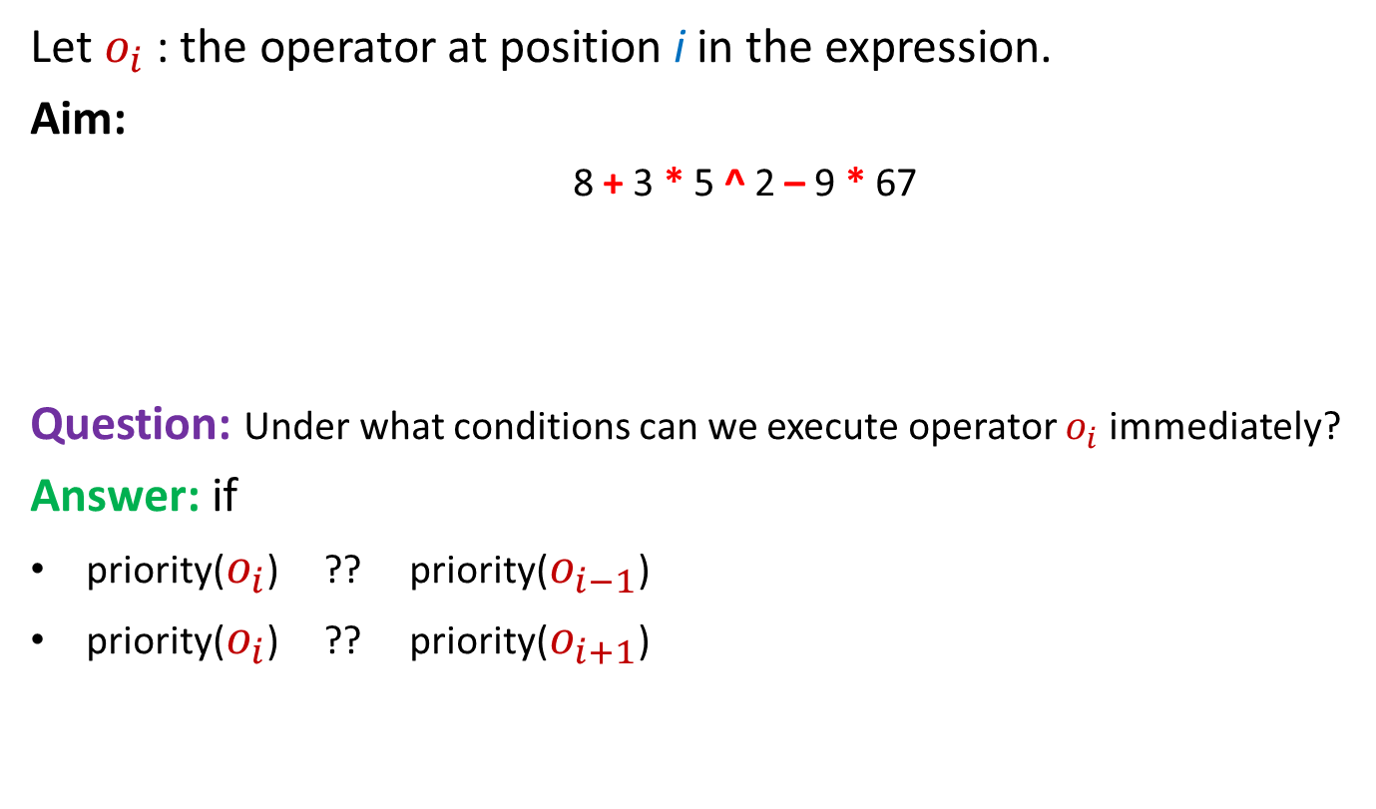
Insight into the problem
Let $o_{i}$ : the operator at position i in the expression.
Aim:
8 + 3 * 5 ^ 2 – 9 * 67
Question: Under what conditions can we execute operator $o_{i}$ immediately?
Answer: if
priority($o_{i}$) ?? priority($o_{i−1}$)
priority($o_{i}$) ?? priority($o_{i+1}$)
To determine an order in which to execute the operators
Position of an operator does matter
>
≥
Give reasons for ≥ instead of >

Slide 36



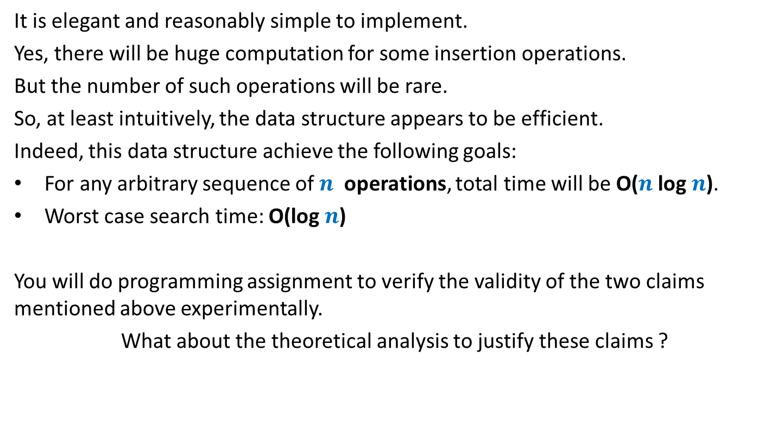

Question: How to evaluate expression in a single scan ?
Expression: $n_{1}{o_{1} n}_{2}o_{2}{ n}_{3}$ $o_{3} n_{4} o_{4}{ n}_{5 }o_{5} n_{6} o_{6}…$
We execute $o_{5}$
$$o_{2}$$
$$o_{3}$$
$$o_{4}$$
$$o_{5}$$
$$o_{4}$$
$$o_{3}$$
$$o_{5}$$
$$o_{6}$$
Priority no.
$$o_{1}$$
$$o_{2}$$
$n_{1}{ n}_{2}$ $n_{3}$
$$n_{4}$$
$$n_{5}$$
$${ n}_{6}$$

Slide 37
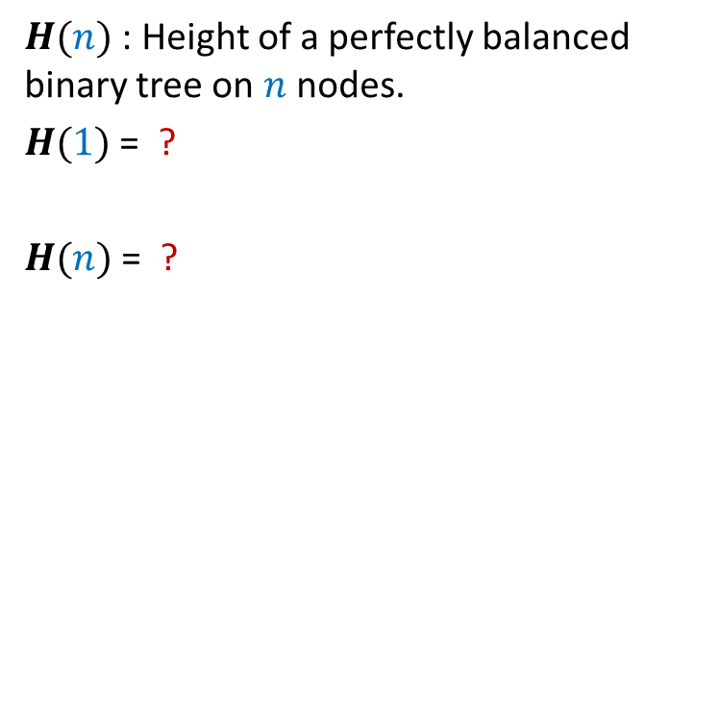


Question: How to evaluate expression in a single scan ?
Expression: $n_{1}{o_{1} n}_{2}o_{2}{ n}_{3}$ $o_{3} n_{4} o_{4}{ n}_{5 }o_{5} n_{6} o_{6}…$
We can execute $o_{4}$
Priority no.
$$o_{1}$$
$$o_{2}$$
$$o_{3}$$
$$o_{4}$$
$$o_{6}$$
$n_{1}{ n}_{2}$ $n_{3}$
$$n_{4}$$
$$n^{′}$$

Slide 38


Question: How to evaluate expression in a single scan ?
Expression: $n_{1}{o_{1} n}_{2}o_{2}{ n}_{3}$ $o_{3} n_{4} o_{4}{ n}_{5 }o_{5} n_{6} o_{6}…$
Priority no.
$$o_{1}$$
$$o_{2}$$
$$o_{3}$$
$$o_{6}$$
$$o_{6}$$
$n_{1}{ n}_{2}$ $n_{3}$
$$n^{′′}$$

Slide 39
Homework:
Spend sometime to design an algorithm for evaluation
of arithmetic expression based on the insight we developed in the last slides.
(hint: use 2 stacks.)

